Slide 1
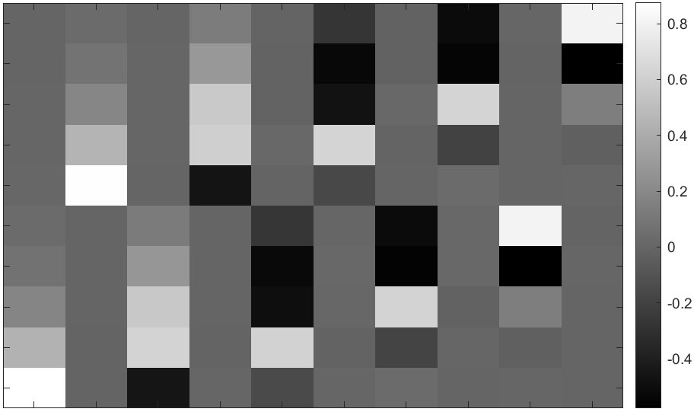
PCA coefficients of steerable gradient filters
% variance explained:
50.6
37.5
5.4
4.5
0.9
0.8
0.1
0.1
0.01
0.01
Horizontal filters: 1px
2px
4px
8px
16px
Vertical filters: 1px
2px
4px
8px
16px
These are the PCA components of the responses of 5 horizontal and 5 vertical gradient filters at different scales, on natural images.
Each column is the coefficients of one principal component, and the columns are sorted by descending variance.
We see that the discovered components flip between vertical and horizontal versions of the same shape.

Slide 2
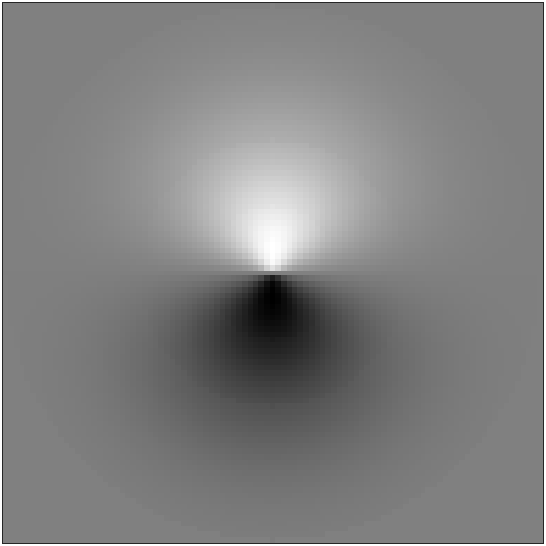
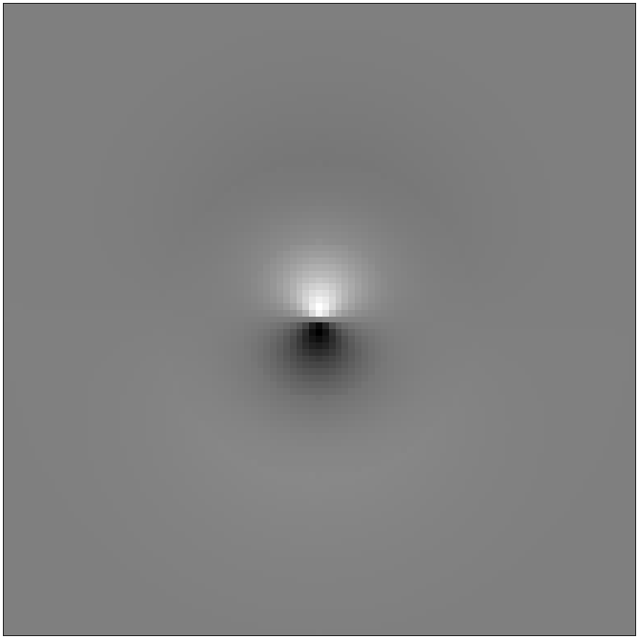
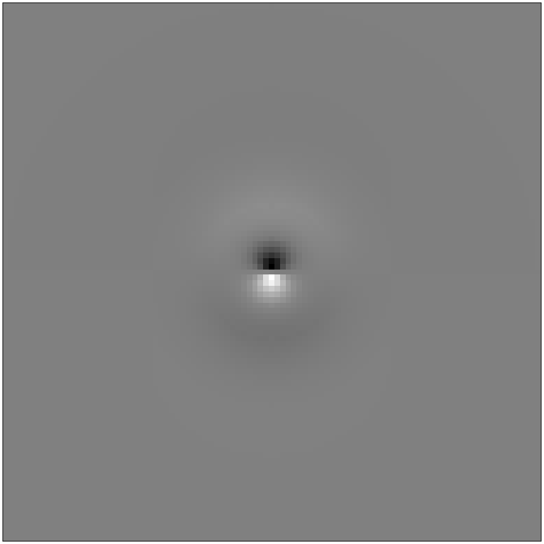
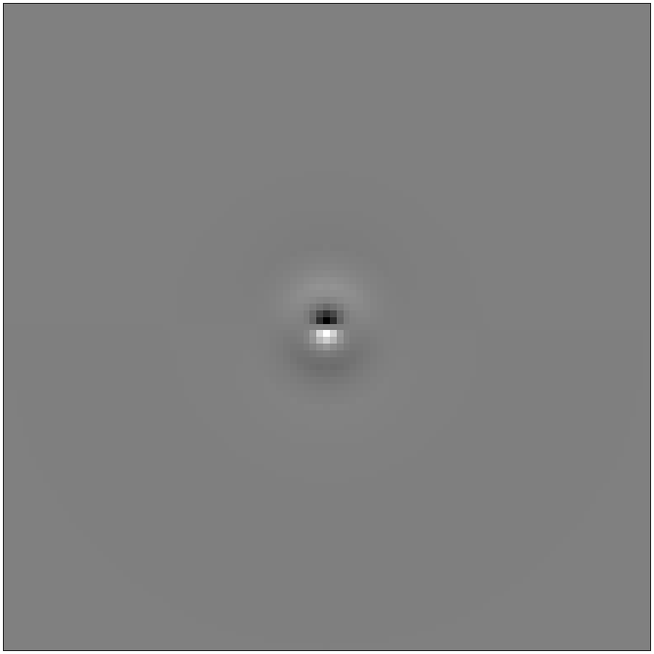
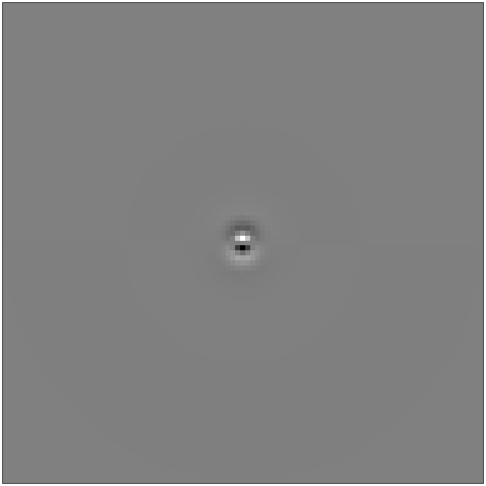
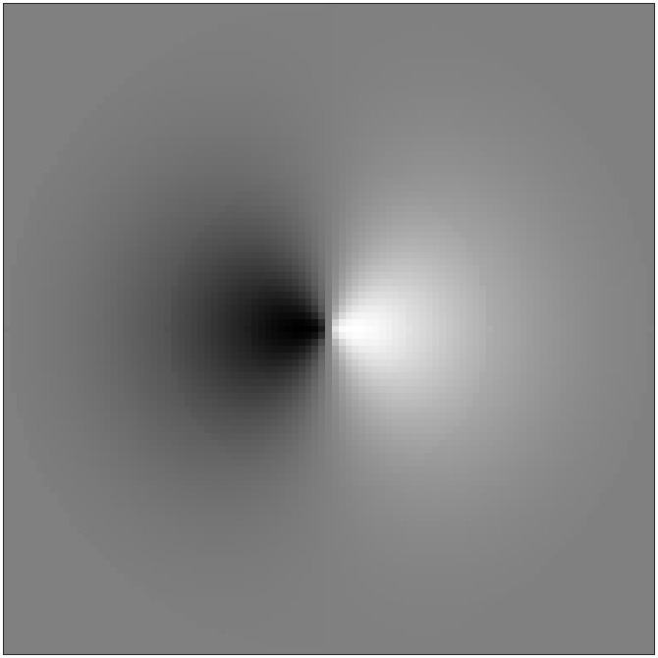
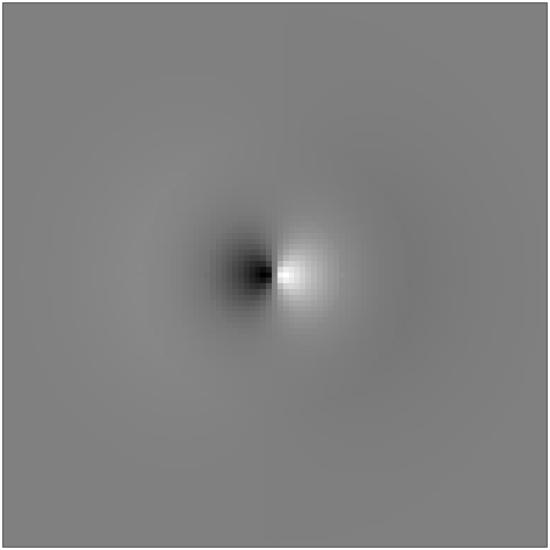
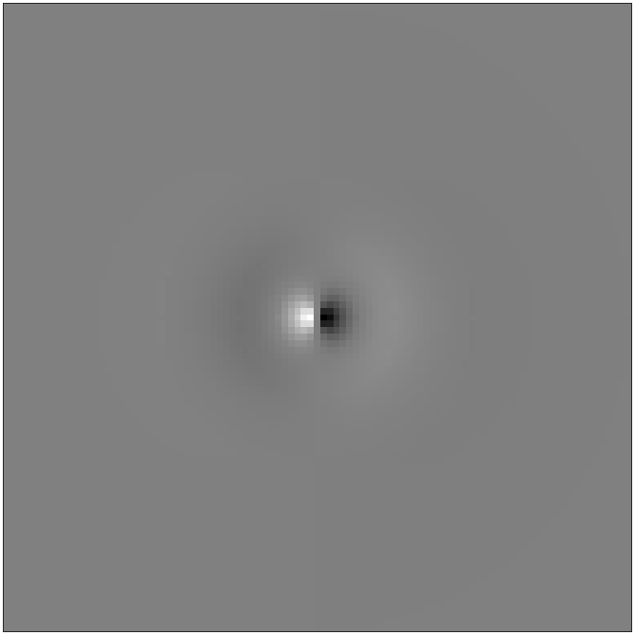
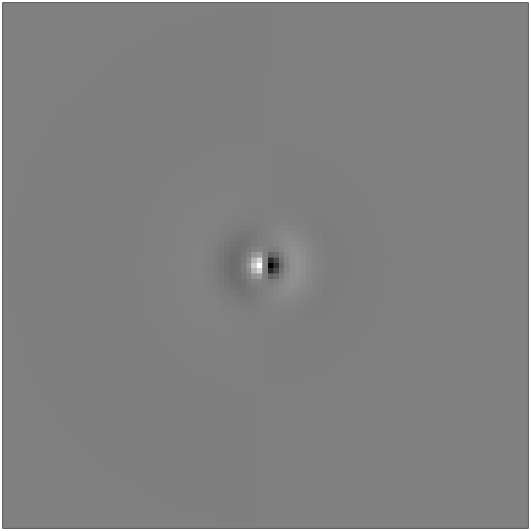
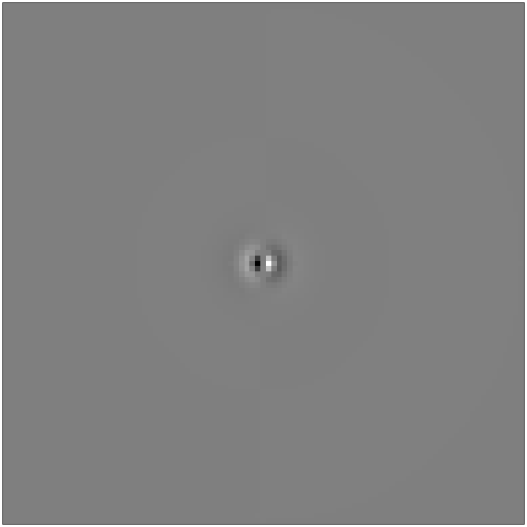
These are the 10 PCA filters, sorted by variance (col 1 row 1, then col 1 row 2, then col 2 row 1 etc).

Slide 3
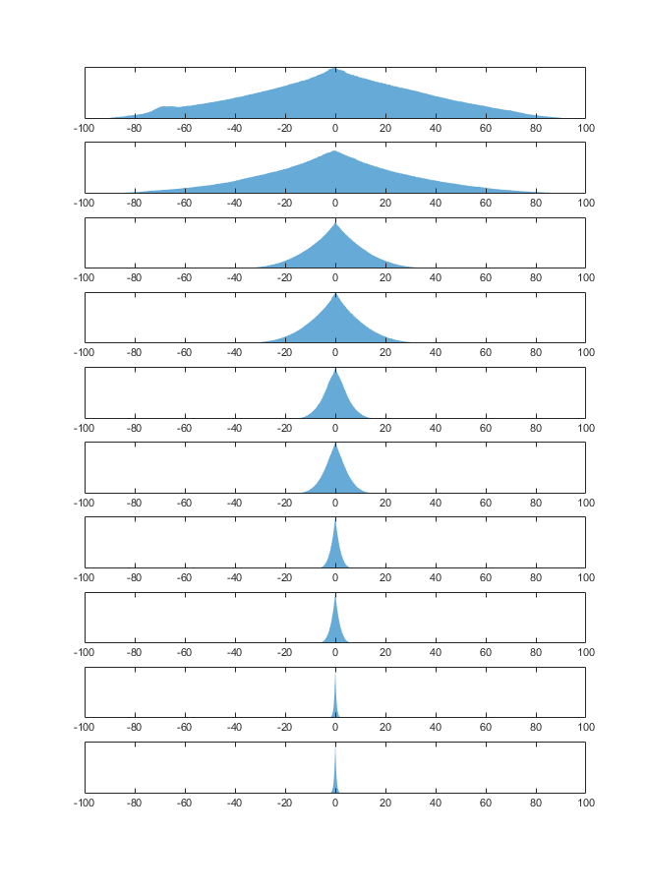
These are the distributions of the PCA scores (i.e. distributions of responses along the PCA axes), ordered by variance.

Slide 4
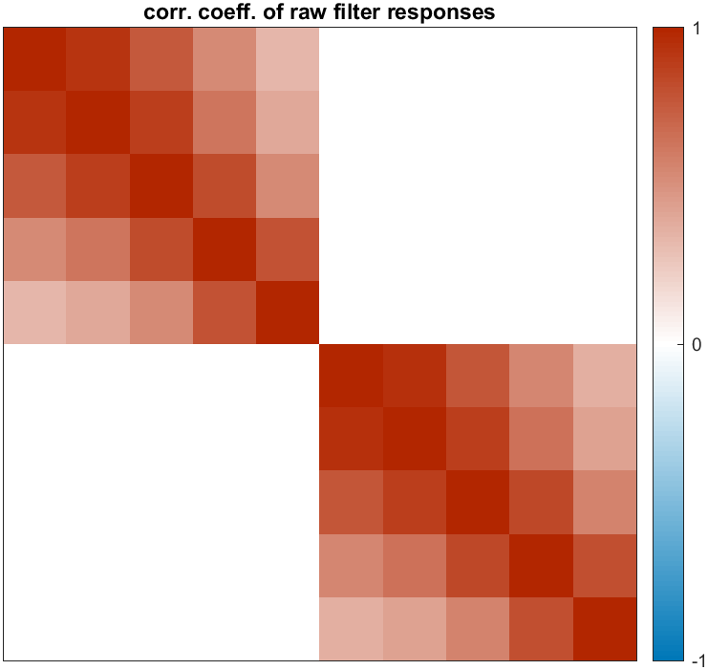
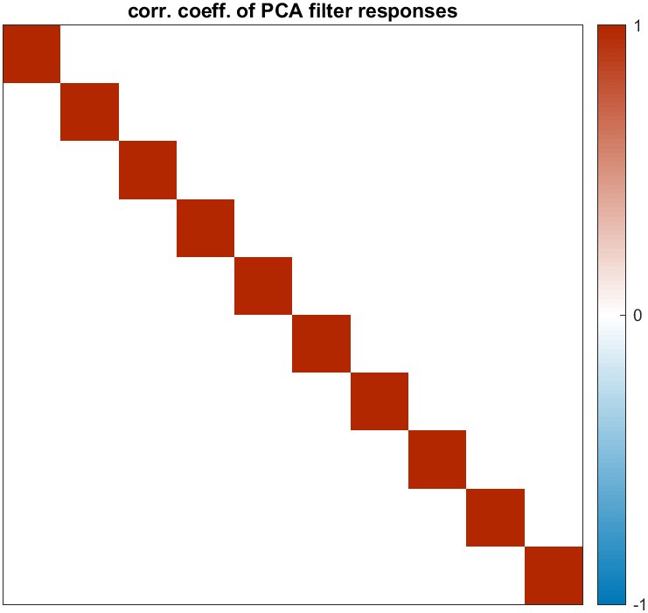
We see that the raw filter responses were correlated across scales in each of the horizontal and vertical sets, but no correlations between horizontal and vertical.

